Slide 1
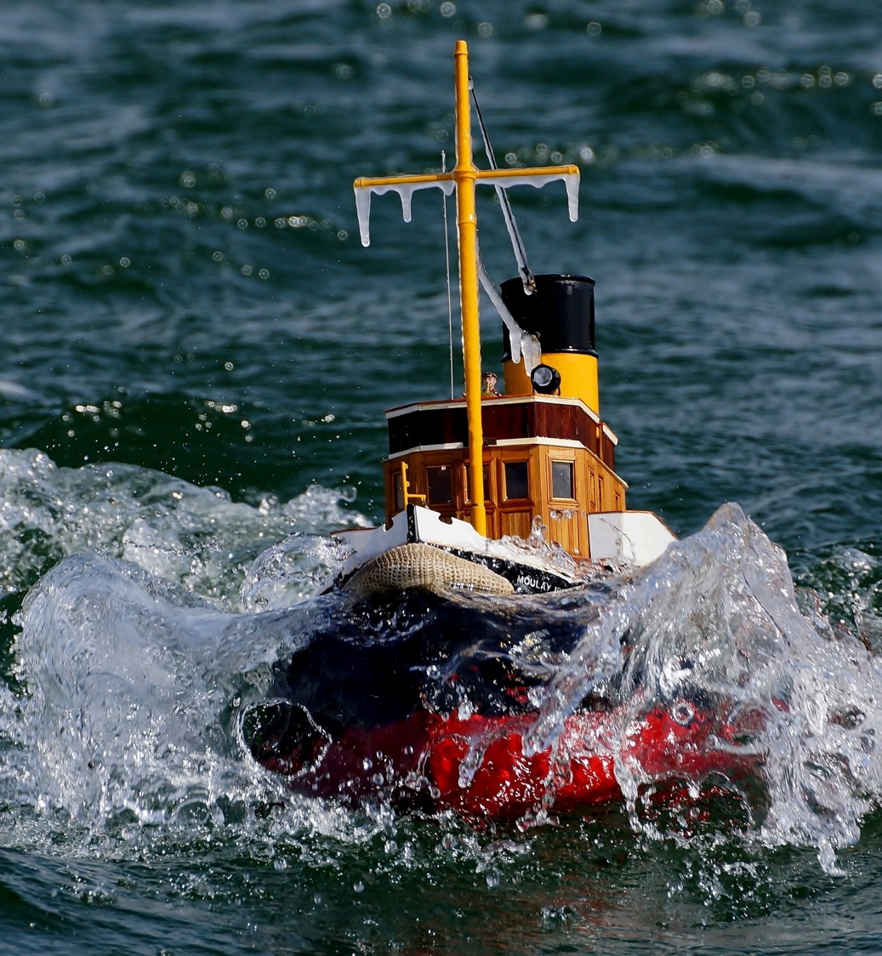
Understanding Oil Spills
Notes:
Welcome participants to Module 2: Understanding Oil Spills. Introduce the session's focus on what happens to oil once it enters the marine environment, and why understanding its fate and effects is essential for effective spill response.

Slide 2
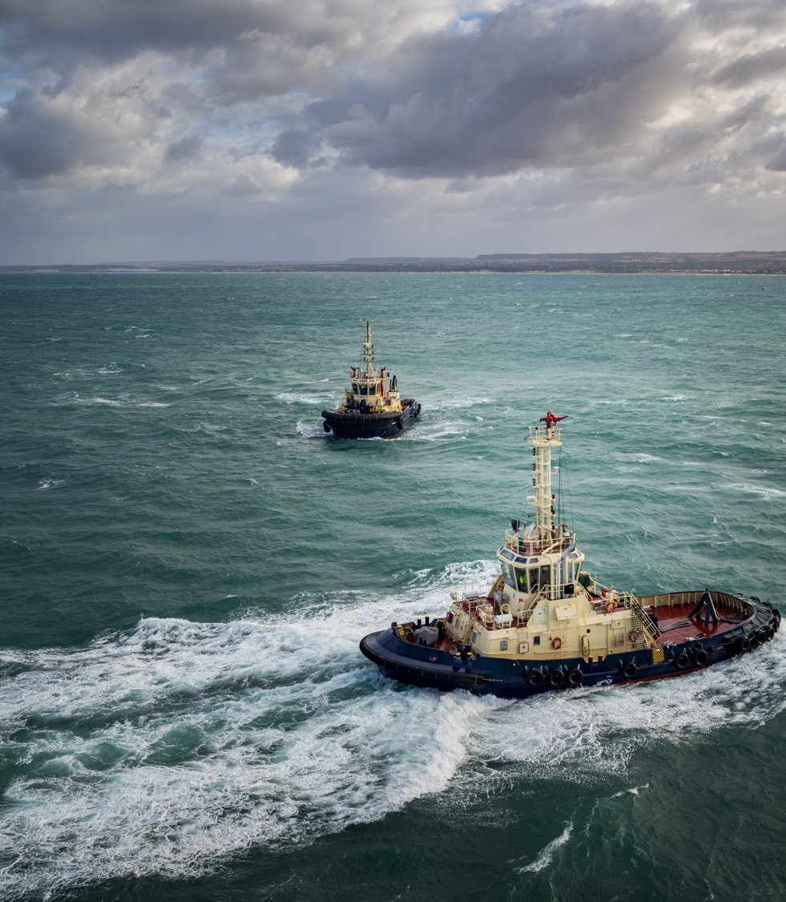

Fate and Effects
Objectives
1
Understand the principal oil weathering processes for surface and sub-surface oil spills
2
Name weathering processes of oil spilt on water
3
Discuss the effects and impacts of spilt oil
Notes:
Walk through the three learning objectives for this session: (1) understand the principal weathering processes for surface and sub-surface oil spills, (2) name the weathering processes that affect oil spilt on water, and (3) discuss the effects and impacts of spilt oil. Let participants know these processes will be introduced one at a time and built up into a full picture over the following slides.

Slide 3
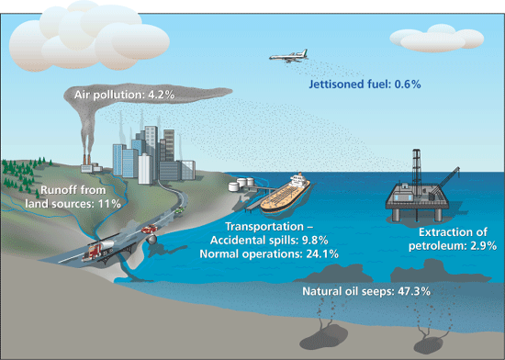
How is oil released into the marine environment?
Notes:
Original Source:
https://www.whoi.edu/oceanus/feature/mixing-oil-and-water/
Facilitation note: Ask participants to consider the different sources of oil entering the marine environment (spills, natural seeps, runoff, operational discharges) before revealing the diagram.

Slide 4
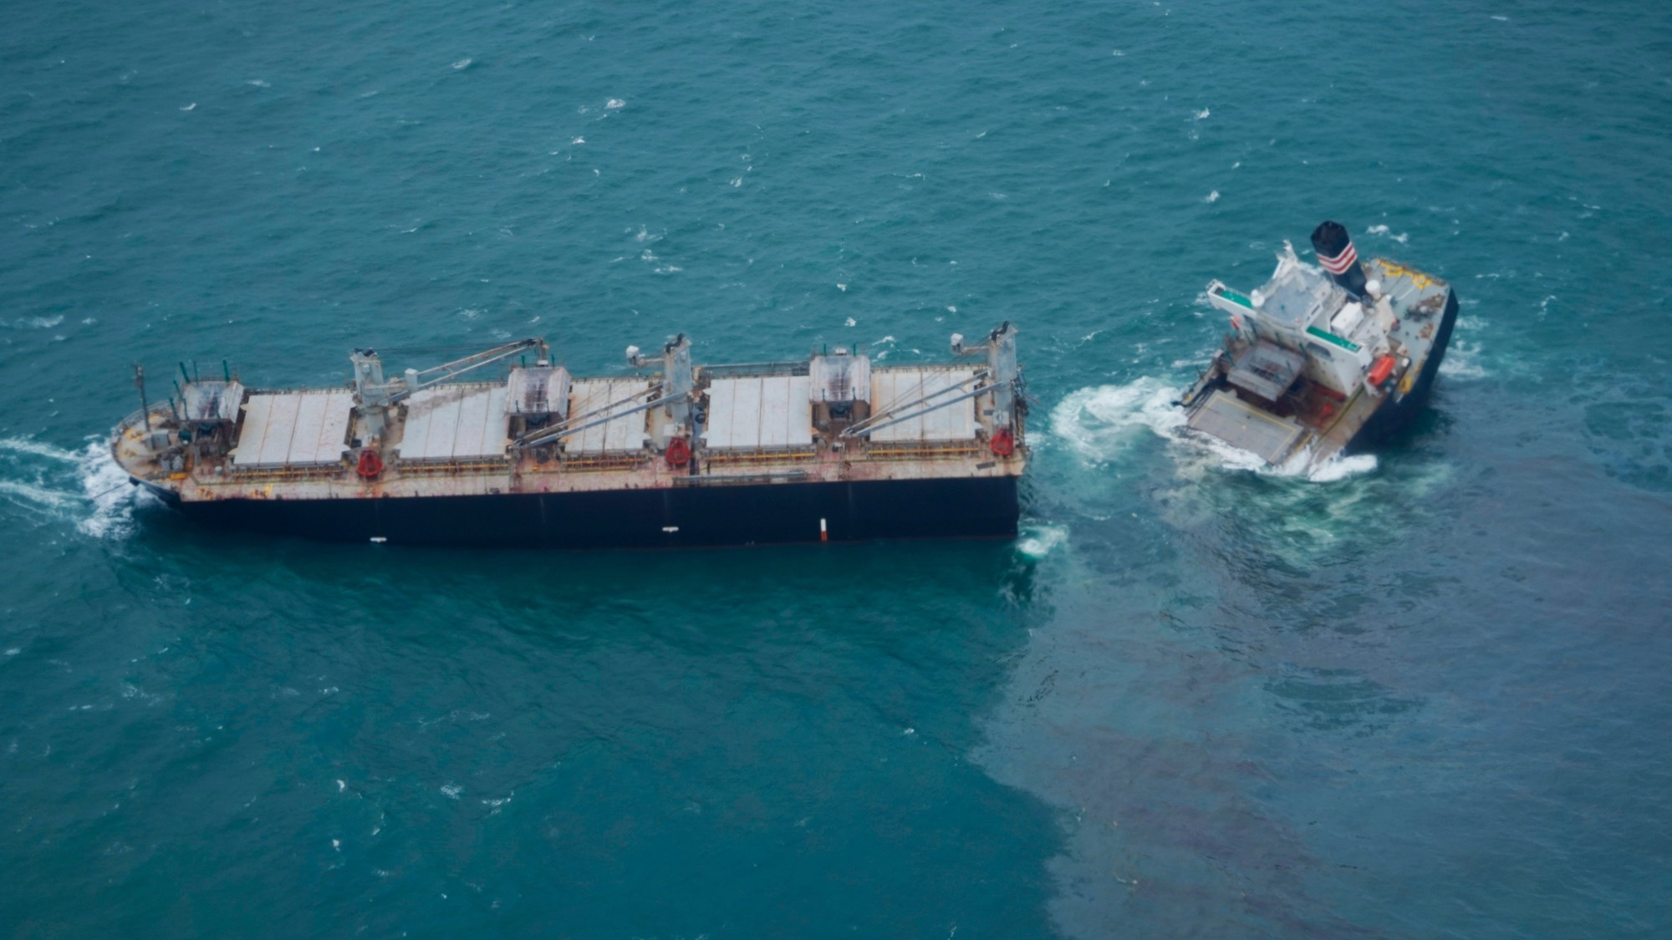
Disaster
Notes:
Section divider. Use this transition to introduce a real oil spill disaster as context, grounding the technical weathering concepts that follow in a real-world event.

Slide 5
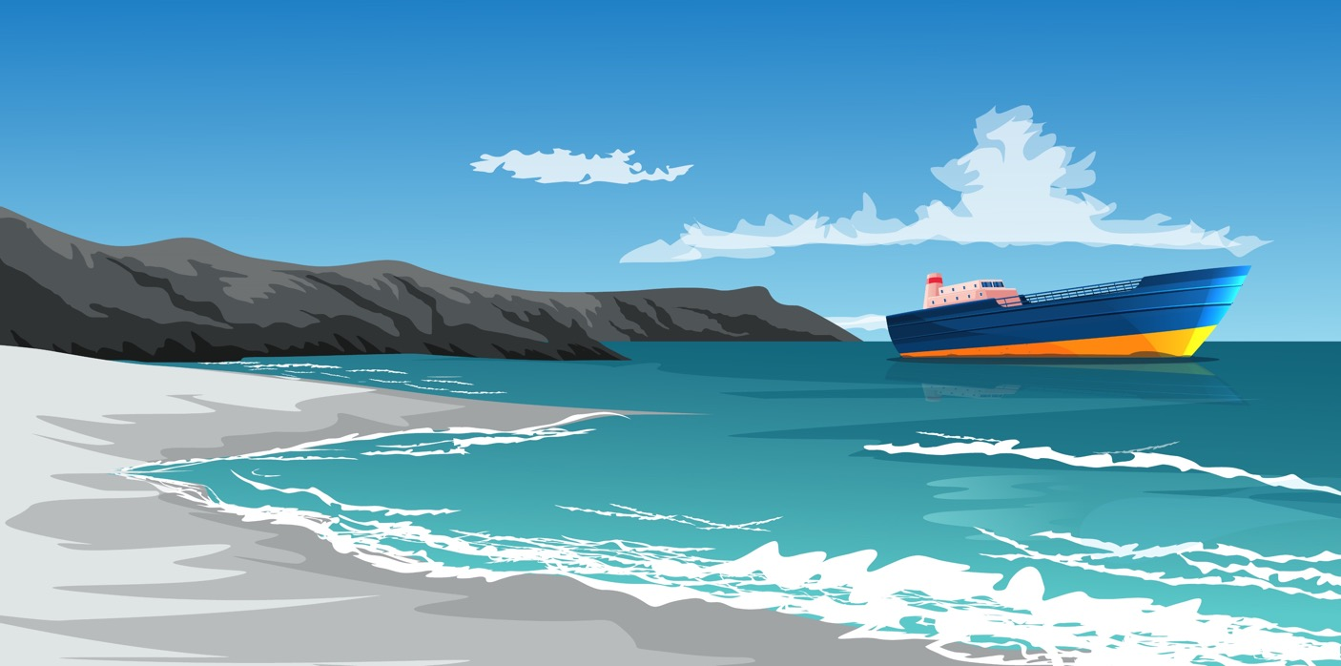
Fate of Spilled Oil
Notes:
Introduce the 'Fate of Spilled Oil' diagram that will be built up incrementally across the next several slides, with one new weathering process added at a time. Explain that spilled oil undergoes a series of physical, chemical, and biological changes over time.

Slide 6
Fate of Spilled Oil
Oil Still Fresh
Spread
Notes:
First stage: Spreading. Explain that fresh oil spreads rapidly across the water surface into a thin slick, driven by gravity, surface tension, and the oil's viscosity. Spreading increases the surface area exposed to other weathering processes.

Slide 7
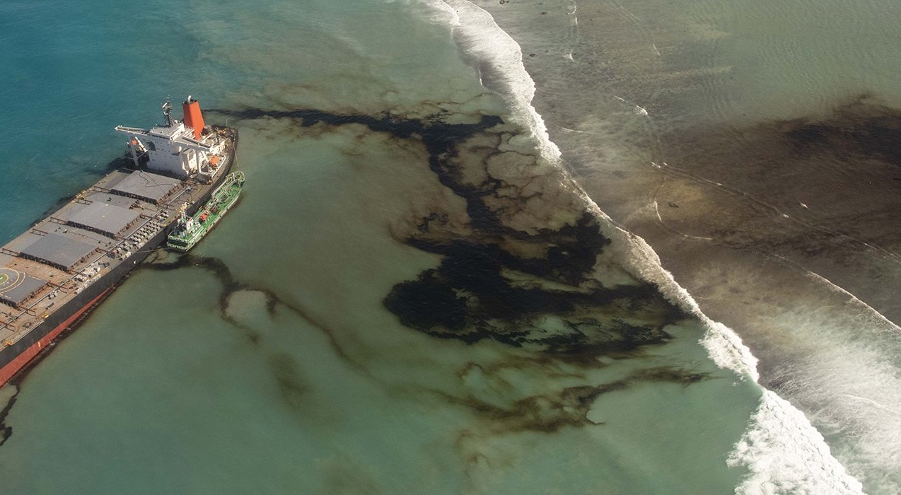
Notes:
Discussion break. Pause here for questions or a quick check on understanding before introducing the next weathering process.

Slide 8

Fate of Spilled Oil
Oil Still Fresh
Evaporation
Spread
Notes:
Add Evaporation to the diagram. Explain that the lighter, more volatile hydrocarbon components evaporate into the atmosphere — most significantly in the first hours to days after a spill — reducing the oil's volume and shifting its remaining composition toward heavier, more persistent compounds.

Slide 9

Fate of Spilled Oil
Oil Still Fresh
Dispersion
Evaporation
Spread
Notes:
Add Dispersion to the diagram. Explain that wave action and turbulence break the surface slick into droplets that mix down into the water column, where they may remain suspended or resurface.

Slide 10
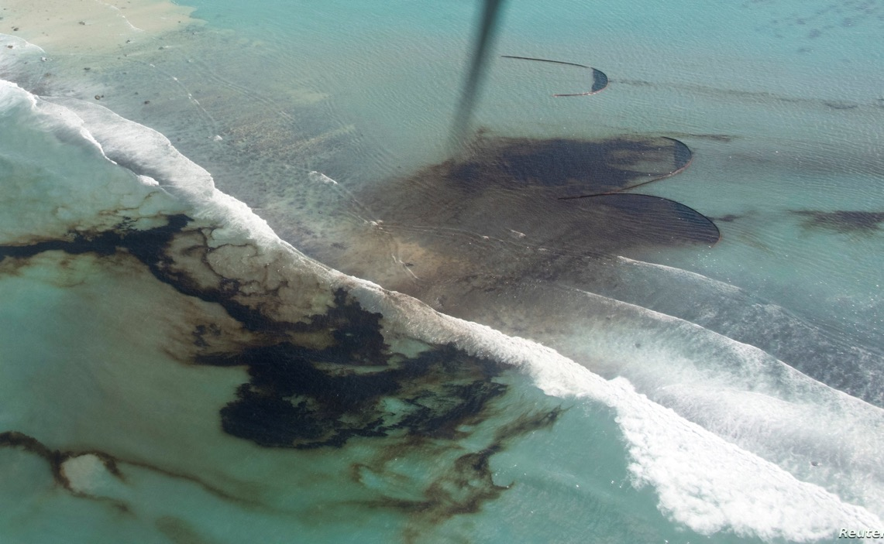
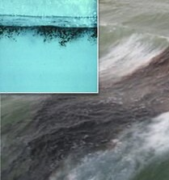
Dispersion
Notes:
Go into more detail on dispersion: the role of wave energy and turbulence in breaking up the slick, how droplet size affects whether oil resurfaces or stays suspended, and the difference between natural and chemically-enhanced dispersion.

Slide 11
Fate of Spilled Oil
Oil beginning to weather
Dispersion
Evaporation
Spread
Fragmentation
Notes:
Add Fragmentation to the diagram as the oil begins to weather. Explain that the once-continuous slick breaks apart into smaller, scattered patches and tar patches as it ages.

Slide 12
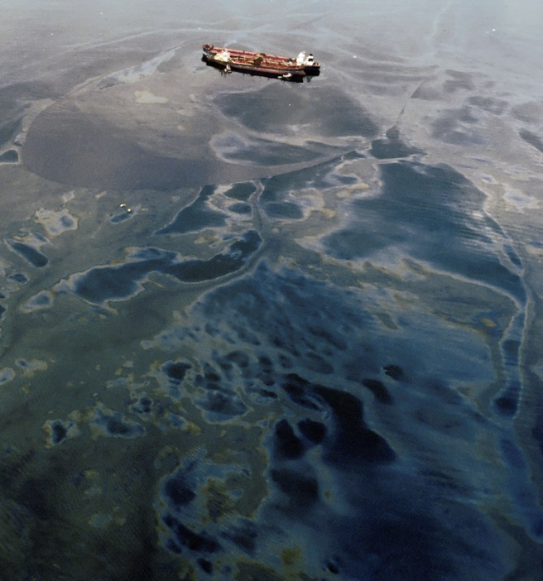
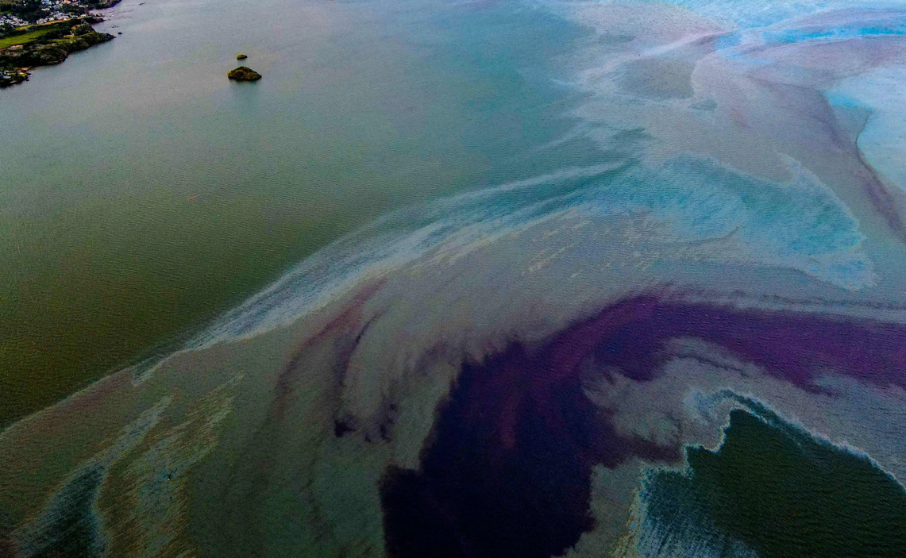
Fragmentation
Notes:
Go into more detail on fragmentation: how a slick transitions from a continuous sheen to discrete patches, and how this affects trackability and cleanup.

Slide 13
Fate of Spilled Oil
Weathered Oil
Dispersion
Evaporation
Spread
Emulsification
Fragmentation
Notes:
Add Emulsification to the diagram. Explain that as oil weathers further it can mix with water to form a water-in-oil emulsion — often called 'chocolate mousse' — which increases the oil's volume, viscosity, and persistence.

Slide 14
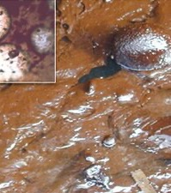
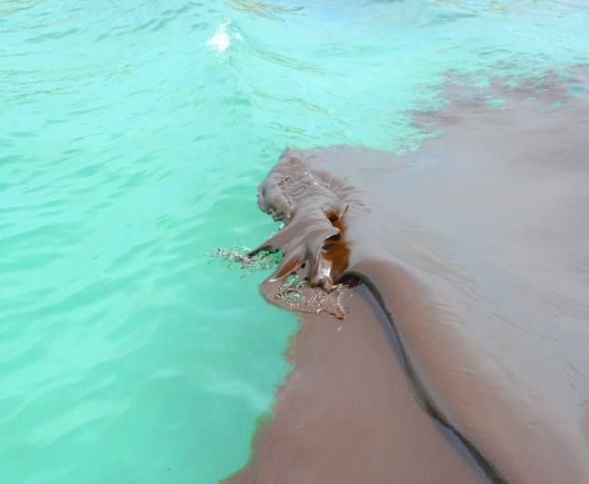
Notes:
Go into more detail on the emulsification process shown in the diagram: how water droplets become trapped within the oil and how this changes its physical properties and behaviour.

Slide 15
Fate of Spilled Oil
Weathered Oil
Dispersion
Evaporation
Spread
Stranding
Emulsification
Fragmentation
Notes:
Add Stranding to the diagram. Explain that weathered oil reaching the shoreline can strand on beaches, rocks, marshes, or other coastal habitats, where it may persist and cause longer-term impacts.

Slide 16
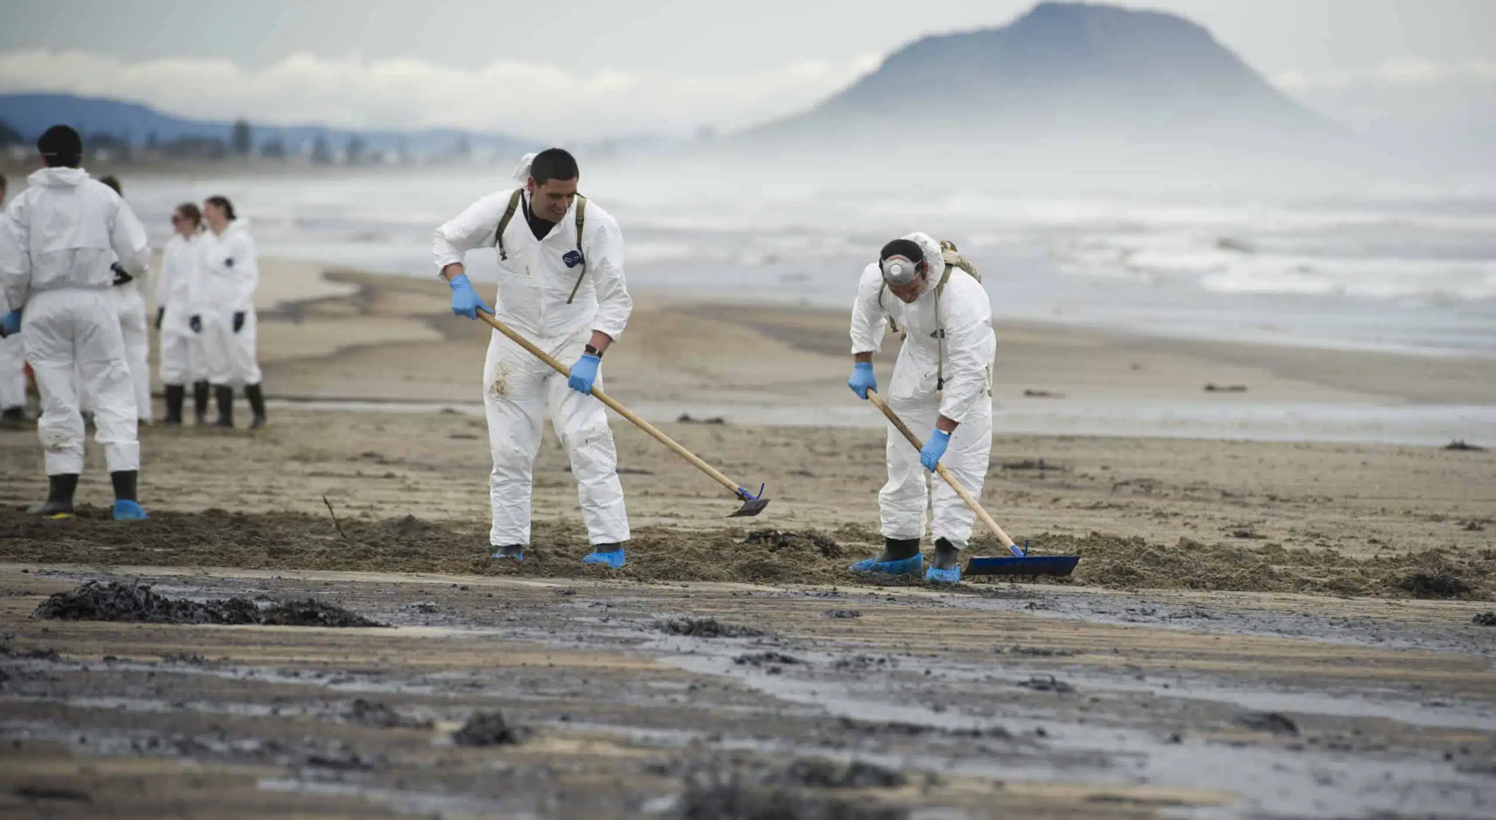
Notes:
Discussion break. Pause here for questions before introducing the final weathering processes.

Slide 17
Fate of Spilled Oil
Weathered Oil
Dispersion
Evaporation
Spread
Stranding
Emulsification
Fragmentation
Sedimentation
Notes:
Add Sedimentation to the diagram. Explain that oil droplets can adhere to suspended sediment particles and sink to the seabed, a process especially important in nearshore, estuarine, and turbid waters.

Slide 18
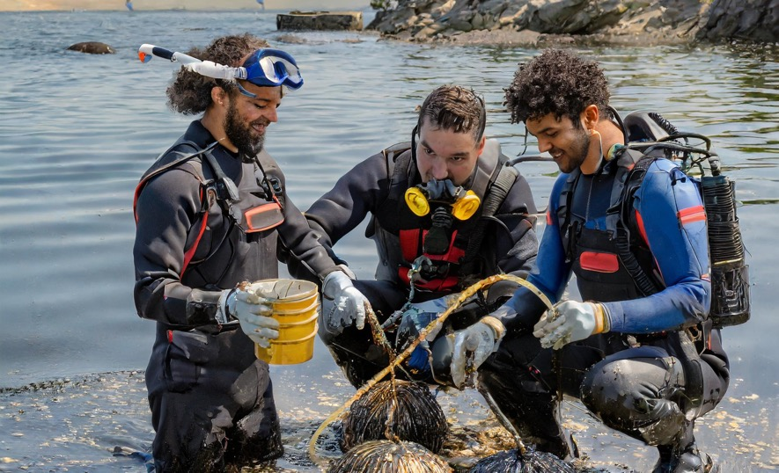
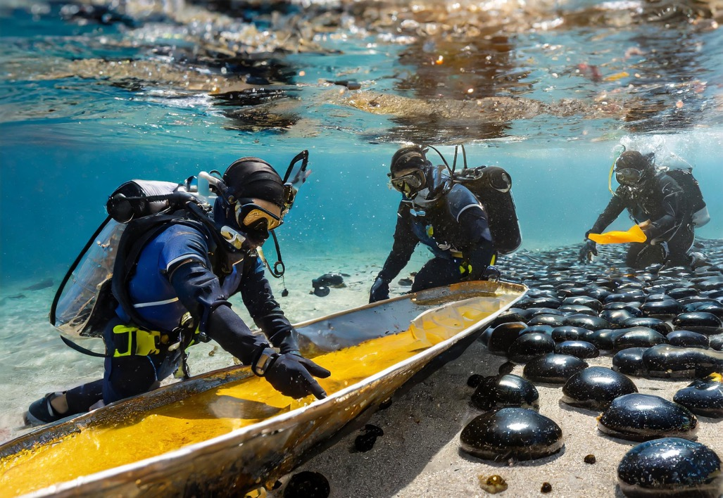
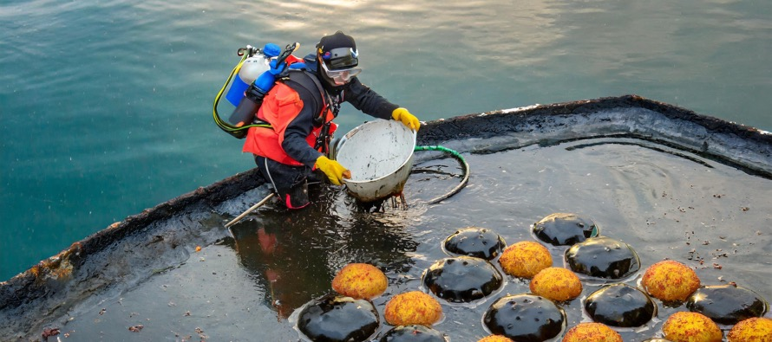
Erika Oil Spill 1999
Notes:
Case study: the Erika oil spill (1999). Use this real-world event to illustrate the weathering processes covered so far — discuss the cause of the spill, how the oil spread and weathered, and its shoreline and sediment impacts.

Slide 19
Fate of Spilled Oil
Weathered Oil
Dispersion
Evaporation
Spread
Stranding
Emulsification
Fragmentation
Biodegradation
Sedimentation
Notes:
Complete the diagram with Biodegradation, the final and typically slowest-acting weathering process. Explain that microorganisms in the water and sediment gradually break down remaining hydrocarbons into simpler, less harmful compounds.

Slide 20
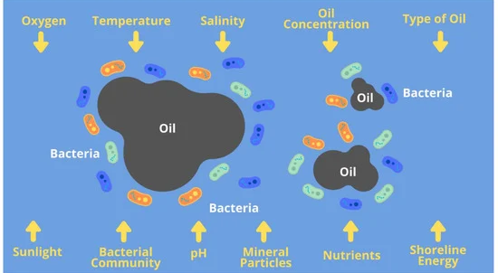
Notes:
Temperature, sunlight, nutrients, shoreline energy, oxygen, type of oil, and initial bacterial community appear to be the most important factors affecting the biodegradation of oil, and crucial factors to consider during biodegradation. Oil degrades faster in warmer temperatures. Photooxidation by natural sunlight is mainly involved in the weathering of oil’s aromatic components in the surface waters. Nutrients such as nitrogen, phosphorus, and potassium increase oil degradation efficiency via hydrocarbon respiration rate and bacterial growth. Physical advection caused by shoreline energy breaks apart oil droplets, thus, the higher the energy of the waves, the more intense the slick breaking and droplet dispersion. Oxygen is another critical factor required for the biodegradation of hydrocarbons, as the initial attack of the hydrocarbon chain involves oxygenases. Most often, hydrocarbons are degraded faster under aerobic conditions. In anaerobic degradation, the microorganisms demand a lot of energy to activate hydrocarbon molecules therefore, the degradation rate is slower. The type of oil pollutant can also affect the ability of the bacteria to perform biodegradation. The most common type of oil that is a major concern during an oil spill is crude oil, further classified into light oil or heavy oil. The biodegradation rate is slower for components with more complex structures, therefore light oils can easily be degraded compared to heavy oils. Moreover, the composition of the initial bacterial community in the spilled area determines the formation of an oil-degrading consortium.
Source: https://www.mdpi.com/2077-1312/10/3/426
Facilitation note: Use this slide to explain the factors that most influence how quickly biodegradation occurs, reinforcing this as the final stage in the fate of spilled oil.

Slide 21
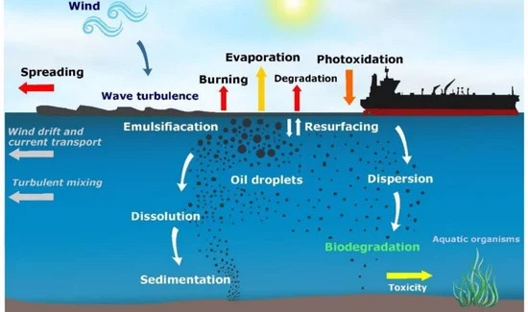
Fate of Spilled Oil
Notes:
Show the completed 'Fate of Spilled Oil' diagram and recap the full sequence of weathering processes covered: spreading, evaporation, dispersion, fragmentation, emulsification, stranding, sedimentation, and biodegradation.

Slide 22
Fate of Spilled Oil
https://vimeo.com/93358246?fl=pl&fe=cm
Notes:
Play the linked video to reinforce the fate and effects concepts covered in this session. Follow up with a brief discussion of the key points shown.

Slide 23
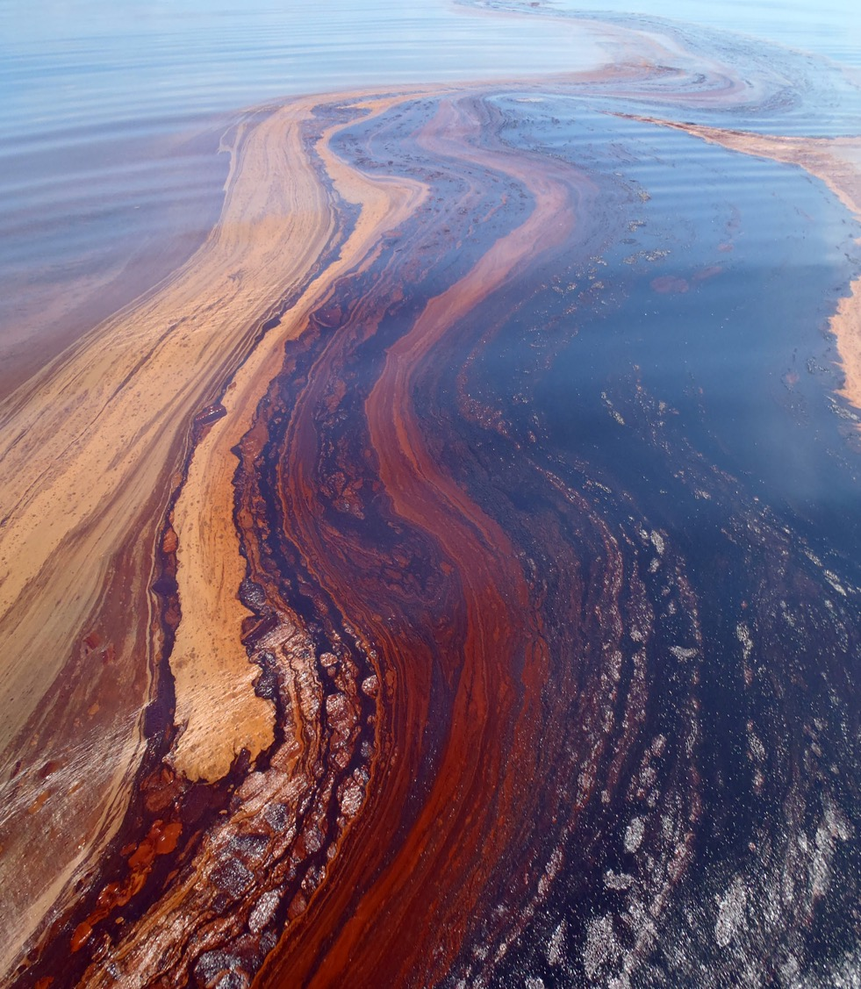
Recap - Fates and Effects
List 3 points you have learnt from this session
Notes:
Recap activity: ask participants to list three points they've learned from this session. Use their responses to check understanding and address any misconceptions before concluding the module.

